Slide 1
PHP Best Practices
Nikolay Kostov
Telerik Corporation
www.telerik.com

Slide 2
Summary
Writing conventions
Type safe code
Exceptions, being E_STRICT
Documentation
Security
Performance
Deployment

Slide 3
Writing conventions (2)
Can you read and understand your old code? Can others read your code?
Don't invent standards and conventions
Use established styles
Use naming conventions
Example: use PascalCaseClassNames
Consider converting underscores to slashes when packaging classes: Spreadsheets_Excel_Writer.php becomes Spreadsheets/Excel/Writer.php

Slide 4
Writing conventions (2)
Name variables camelCased, with first letter lower case
Constants names should be ALL_CAPS_WITH_UNDER_SCOPES
Prefix private methods and properties of classes with an _underscope
Use four spaces instead of tabs to indent the code
Keeps viewing consistent across viewers

Slide 5
Type safe coding
PHP is loosely typed
May lead to unexpected results and errors
Be careful when using normal comparison operators
Replace with type-safe where needed
Use type casting and explicit type conversions

Slide 6
Short open tags
<?, <?= and <% are being deprecated
<? is XML opening tag
<?= is complete invalid XML
<% is ASP style tag
If there is code in more than one language in one file, short open tags may lead to confusion of parsers
Use <?php instead

Slide 7
Exceptions
Handling exceptions and warnings is cool but dangerous
If exceptions are misused may lead to more problems that solve
Use only when really needed
Exceptions may leak memory
The memory, allocated for the for-loop does not get freed
for ($i = 10000; $i > 0; $i –-)
throw new Exception ('I Leak Memory!');

Slide 8
Being E_STRICT
A lot of functions are being deprecated
In PHP 5 using certain functions will raise E_STRICT error
In PHP 6 those will become E_FATAL
Example:
Function is_a is deprecated
Use instanceof instead
if (is_a($obj, 'FooClass')) $obj->foo();
if ($obj instanceof 'FooClass')) $obj->foo();

Slide 9
Source Documentation
phpDocumentor tags are similar to Javadoc
Standard for generating documentation
Describes functions and classes, parameters and return values
Tools use them to generate code-completion, technical documentation and others

Slide 10
Source Documentation
Example of phpDocumentor tags
Follow to next page
/**
* MyClass description
*
* @category MyClasses
* @package MyBaseClasses
* @copyright Copyright © 2008 LockSoft
* @license GPL
**/
class MyClass extends BaseClass {

Slide 11
Source Documentation
/*
* Easily return the value 1
*
* Call this function with whatever
* parameters you want – it will
* always return 1
*
* @param string $name The name parameter
* @return int The return value
** /
protected foo ($name) {
return 1; } }

Slide 12
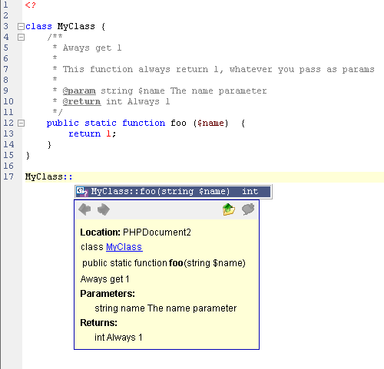
Source Documentation
Example how Zend utilizes the tags at runtime

Slide 13
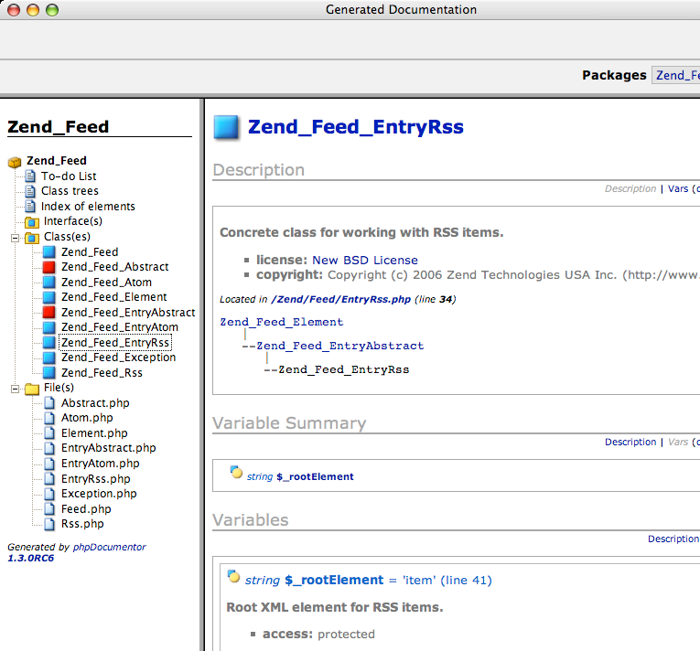
Source Documentation
Tools can generate sophisticated documentation based on the tags

Slide 14
Security
Never use variables that may not be initialized
Never trust the user input
Always be careful about the content of $_POST, $_GET, $_COOKIE
Use white list of possible values
if (valid($_POST['user'], $_POST['pass']))
$login = true;
if ($login) …
<form action="<?=$_GET['page']"> …
require $_GET['action'].'.php';

Slide 15
Security
Always hide errors and any output that may contain system information
Knowledge about paths and extensions may make it easier to exploit the system
Never leave phpinfo() calls
Turn off display_errors on deployment server
Turn off expose_php

Slide 16
Security
Check file access rights
No writeable and executable files should be kept in the web root
No writeable PHP files
Disallow access to files that contain configuration on a file system level
Never give permission to OS accounts that do not need access

Slide 17
Security
Always check for and turn off magic quotes
Use add_slashes and other escaping functions
Pay special attention to user input that goes into SQL statements
Consider using prepared statements
Always check for and turn off register_globals

Slide 18
Performance
PHP internal function are much faster than user functions
Because they are inbuilt and coded in C
Read the manual and check if you reinvent the wheel
If you have slow functions, consider writing them in C and adding them as extensions to PHP

Slide 19
Performance
Simple optimizations save a lot time
Use echo with multiple parameters instead of multiple calls or concatenation
Optimize loops
echo 'Hello', $world;
for ($i = 0; $i < count($arr); $i++)
for ($i = 0, $n = count($arr); $i<$n; ++$i)

Slide 20
Performance
Keep objects and classes in limit
PHP 5 adds cool OO features
Each object consumes a lot memory
Method call and property access take twice more time than calling function and accessing variable
Do not implement classes for everything, consider using arrays
Don't split the methods too much

Slide 21
Performance
Most content is static content
Always check your site with tools like YSlow and IBM Page Detailer
Apply caching for all the static content
Use Last-Modified for database content with the date of the record last update
Consider using PHP optimizers
Compiles the code and uses it instead, until source file changes

Slide 22
Performance
Use mod_gzip when you can afford it
Consumes a lot CPU, because it compresses the data on the fly
Saves up to 80% data transfer
Be careful – some browsers may have issues if some file formats are delivered with gzip compression
Example: Internet Explorer 6 and PDF

Slide 23
Performance
Think about every regular expression – do you need it?
Takes a lot of time because of the back tracking
Use only when necessary
Check if it can be optimized with possessive operators and non-capturing groups
If the expression is simple, use ereg, instead of preg

Slide 24
Design Patters
Always check what is out there
PEAR, Zend Framework and others are proven
Issues have been cleared
Object Oriented, slower
Use standard architectures like MVC
Strip the database abstraction layer and object from the core logic and the view (the HTML files)

Slide 25
Deployment
NEVER edit files on a production server, live site or system
Use source repositories with versions and deployment tags
When developing, use development server
Must match the production one
Even better – get a staging server that mimics the deployment environment
Deploy there for testers

Slide 26
Deployment
Never override files on the server
Use symlinls, create a separate directory with the new files, link to it
Never manually interact with the server
Write a script that deploys the files without human interaction
Always run a second test on the deployed project

Slide 27
PHP Best Practices
?
?
?
?
?
Questions?
?
?
?
?
?
http://academy.telerik.com

